Slide 1
Open Source Platform and Network Administration
Lesson 8

Slide 3
Learning Objective
Explain user account management and the principle of least privilege to protect and secure the system and its data.

Slide 4
Key Concepts
Policies for user accounts
Boundaries for the user, system, and root accounts
Group accounts for managing the security process
Pluggable Authentication Modules (PAM)
Special user privileges for accessing files, including the executable files

Slide 5
The Shadow Password Suite: Fundamental Files
/etc/passwd
/etc/group
/etc/shadow
/etc/gshadow

Slide 6
Managing Password Change and Expiration Dates
The following change commands are used to enforce password change and expire accounts:
The command to enable user “jdoe” to change password at next login: [root@is418 ~]# chage -d 0 jdoe
The command to expire the user account “jane” on May 31, 2011: [root@is418 ~]# chage -E “05/31/2011” jane

Slide 7
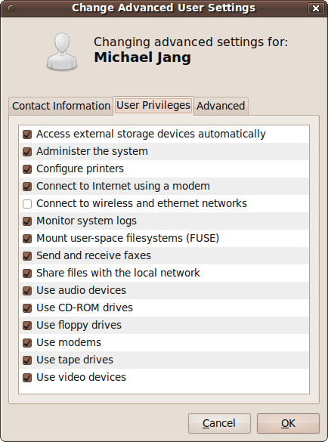
User Privileges as a Member of Special Groups

Slide 8
Group Account
Groups provide a way to better manage accounts in the following ways:
Permissions can be given to a group rather than individuals.
Employees can be added or deleted from predefined groups.
Groups improve the maintainability of user accounts.
Notes:
For example, 500 plus users in a finance department needing special privileges to accounting files can be managed in groups.

Slide 9
Defining the User Account Policy
Who needs access and why?
How long does a user need access?
Where will the user access the computer system from?
What are the tasks the user needs to perform?

Slide 10
Linux System Administrator
Creates user accounts
Enforces user account and password policy
Establishes user account policy

Slide 11
Using sudo Command
1
As a root user, issue the following command: [root@is418 ~]# visudo
2
Enable ALL privileges to user “jdoe” by using the following command: jdoe ALL=(ALL) ALL
3
Login as “jdoe” and use the following sudo command: [jdoe@is418 ~]# sudo useradd maryj

Slide 12
Files with Access Control List (ACL) Permissions
ACL grants special permissions that are not part of the regular file permissions.
These files are used to provide a user or group special access to a file or executable without changing the file permissions.
Permissions can be granted to a user (u), a group (g), and others (o).
Permissions are typically read, write, and execute.
Notes:
Types of permissions example:
A file may have the following permissions:
-rw-rw---- root.root /etc/secret_file.txt
The first ‘-’ means this is a file not a directory.
The next three characters ‘rw-’ means the owner has read and write permissions but cannot execute these permissions as denoted by the ‘-’ symbol.
The next set ‘rw-’ represents the group owner has read and write permissions.
The next set ‘---’ means others have no permissions at all to the file.
The next set ‘root.root” is the user owner and the group owner, user_owner.group_owner, which is root for the user owner and root for the group owner in this file.
If we have a user who needs permissions to read the secret_file.txt file but does not need to change the file permissions, an ACL can be set to grant permission to a specific user or group to read the file.
Scenario example:
The user Jane needs special access to read the mail logs. By default, only the root account can do this. Jane doesn’t need any other privileges, so we can assign an ACL privilege for her to read the /var/log/maillog file by using the following command:
Su –c ‘setfacl -m u:jane:r /var/log/maillog’
setfacl is the command to configure ACL permission
The –m switch is to ‘modify’
‘u:jane’ specifies user Jane. If this was a group, we would use g:group_name.
:r specifies ‘read’ permissions’
/var/log/maillog is the file path we are granting permissions for Jane
To, verify the permissions are granted to user Jane, use the following command:
getfacl /var/log/maillog

